Slide 1
EU-China relation and de-risking global decarbonization
Alicia García-Herrero, Senior Research Fellow at Bruegel

Slide 2
EU-China relations have deteriorated since the zenith reached in December 2020 with the agreement on a Comprehensive Agreement on Investment (CAI). Here are some reasons beyond economics March 2021: sanctions on some MEPs and European think-tanks January 2020: Covid and the related lack of transparency on origin February 2022: China’s stance on Russia’s invasion of Ukraine Since then economic reasons have piled up: large bilateral deficit, overcapacity in China stemming from aggressive industrial policy, persistent lack of market access, difficulties in cross-border data transfer, ”induced” localization and related tech transfer 3. China: Risk on potential overcapacity for green tech

Slide 3
1. Zooming into our trade-investment relations

Slide 4
Since the pandemic, the EU’s trade deficit with China has ballooned to USD 418bn in 2022 from a rather balanced position in the early 2000s. The trend has reverted somewhat in 2023 although mostly for cyclical reasons. The deficit could increase further in 2024 as the ICT cycle comes back

Slide 5
China’s imports are now growing at a slower rate than global trade. Moreover, Chinese imports from the EU, including Germany, have done worse than the global average

Slide 6
One of the reasons for the huge increase in European imports from China is the competitiveness gains China has made from deflationary forces and a cheap RMB

Slide 7
China’s outbound FDI has also been coming down since the start of the pandemic, and has become more targeted in the manufacturing sector, a longstanding key comparative advantage for the EU, an especially in autos

Slide 8
2. Growing strategic dependences, especially in green tech

Slide 9
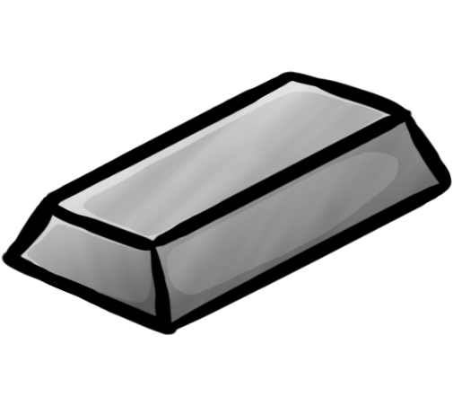
China dominates the whole value chain in green tech
Extraction
Refining
Intellectual Property
Manufacturing

Slide 10
In terms of extraction, China’s concentration concerns far more than just rare earth metals. There are other metals where the concentration is even higher, and this does not even include China’s ownership of mines abroad.

Slide 11
Particularly, the concentration in refining is very high for many critical minerals
Refining

Slide 12
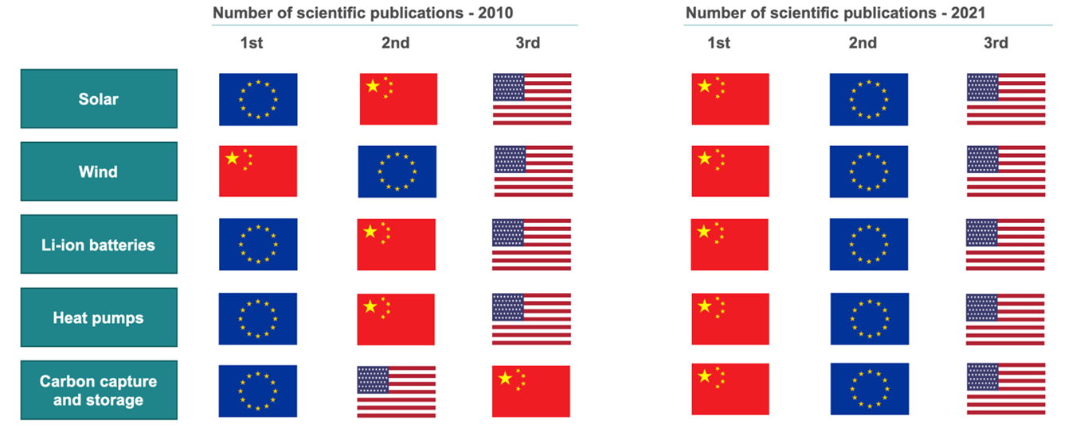
On Innovation, China is also catching up quickly, obtaining a leading position in many areas

Slide 13
China has developed a firm grip on the manufacturing of green energy products, especially solar PV. As of now, China captures 90% of solar PV manufacturing, 60% of batteries, and 43% of wind turbines. It’s a huge concentration on the manufacturing side as well.

Slide 14
Risks from excessive concentration of supply chain of green tech
Two types of risks related to China’s dominance of supply chains for global decarbonization: 1. Unintended risk: Potential disruptions in China’s supply chains of green energy due to climate-related disasters or other shocks.
2. Intended risk: Retaliation from China’s side, as a response of the EU aligning with US on chip ban/ sanctions or any other factor.

Slide 15
A potential solution would come from a Decarbonization Partnership
Even if Chinese supply chains continue to dominate the market, a group of countries could build a supplementary supply chain based on coordinated specialization.
Countries would join on the basis of their capacity and comparative advantage in joining parts of the supply chain:
For more details, check our Bruegel Policy Brief “De-risking and decarbonising: a green tech partnership to reduce reliance on China” https://www.bruegel.org/policy-brief/de-risking-and-decarbonising-green-tech-partnership-reduce-reliance-china

Slide 16
3. Overcapacity as a key risk going forward

Slide 17
Even green tech is moving towards overcapacity Slower domestic demand growth means China may export more overseas for batteries and solar panels
N.B. Overcapacity defines as more capacity than sales in China, and global demand is beyond the scope.
Source: Natixis

Slide 18
Price war for Evs on the radar EV prices in China have generally declined after Tesla cut prices in Q4 2022, and China has exported more to the world after the pile-up of inventories (higher domestic production than demand)

Slide 19
Collapse of solar panel prices Weaker export demand has crashed solar panel prices due to overcapacity, but it is rather transitional than structural

Slide 20
4. Conclusions

Slide 21
The bilateral trade deficit has been rapidly growing for the EU with China, investment relations also worsened since the start of the pandemic. More importantly, the EU’s strategic reliance on Chinese imports in critical sectors has called for a de-risking strategy.
Then EU’s high dependency on China for green tech exports covers the whole supply chain, not only manufactured products, making derisking difficult
Growing overcapacity is pushing down prices which will probably lead to a price war, again adding to the difficulties of derisking.
However, there are plenty of intended and untended risks that make de-risking from China, especially for green tech crucial.

